Slide 1
Operating Systems - Course Overview -
Dept. of Computer Science
Hanyang University

Slide 2
Class Operation: SMART-F
Theory Class
Traditional OS theories
We deal with the “concept” of each technique not the “implementation”
So, most program code presented in the lecture is not real-world code
On-line contents (no offline classes)
You must watch weekly online contents before attending lab classes!!!
Lab. Class
Two hours (exactly, 100 minutes) of offline classes
10831: Thursday (17:00 – 18:40), ITBT 508
12754: Friday (11:00 – 12:40), ITBT 508
12755: Friday (15:00 – 16:40), ITBT 207
Practice of key OS theories on the ‘xv6’ educational OS
4 assignments (one easy and three difficult xv6 programming)
Detailed introduction will be given by TAs
Course Materials
Weekly online contents (together with PPT slides file) will be uploaded right after the Lab class of the previous week

Slide 3
Grading
Midterm
35%
4월 26일(토) 오전 10시 – 11시 40분 (장소 추후 공지)
시험 범위: 직전 수업 내용까지
Final
35%
6월 21일(토) 오전 10시 – 11시 40분 (장소 추후 공지)
시험 범위: 전체
Homework
30% (If three or more assignments have been submitted)
F (otherwise, regardless of the exam. scores)

Slide 4
Absence Policy
Absence policy
Three absences will downgrade the final grade by 1 step
Ex. Tentative grade (by the original grading policy) A+ ➔ Final grade A
More than 8 absences w/o due notice: definitely F
Watch weekly online contents until the day before the lab class (23:59 firm deadline)!!!
Otherwise, will be regarded as an absence to the theory class
Late policy (applied only in Lab. classes)
Definition of the ‘Late’: Appear within 15 min. after the class time
After 15 minutes, no late but absence!
Three times of late will be regarded as an absence
Binary policy (attend or absence) for theory classes
Escape policy: rigorous discipline for dishonesty (in Lab. classes)
Definition of the ‘Escape’: disappear w/o due notice after the attendance check and before class ends
An escape will be regarded as two absences
More than one escape: definitely F

Slide 5
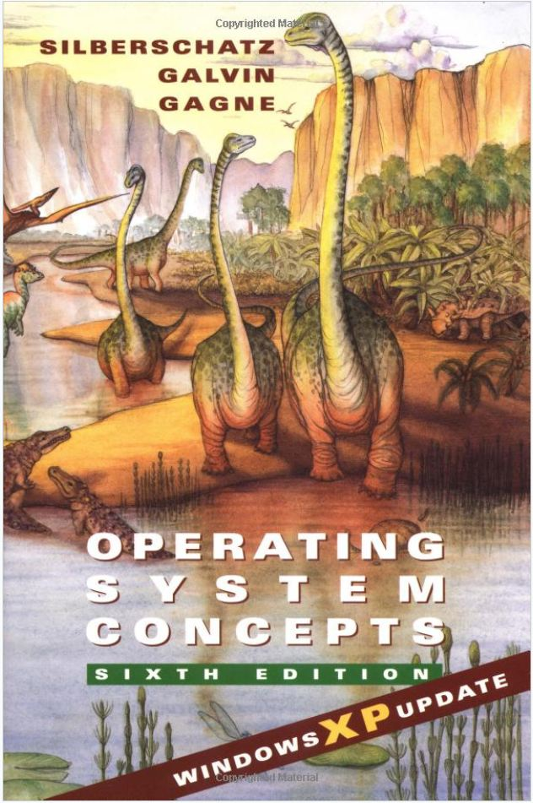
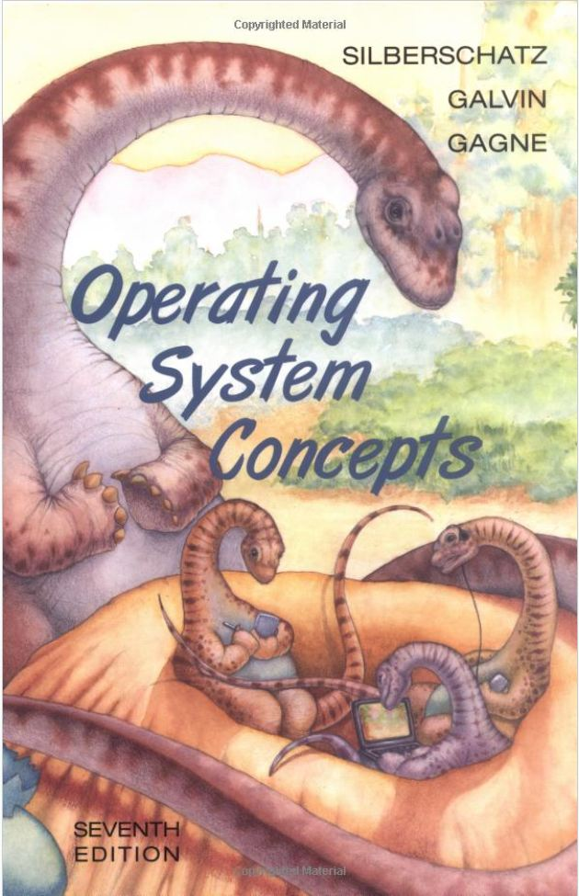
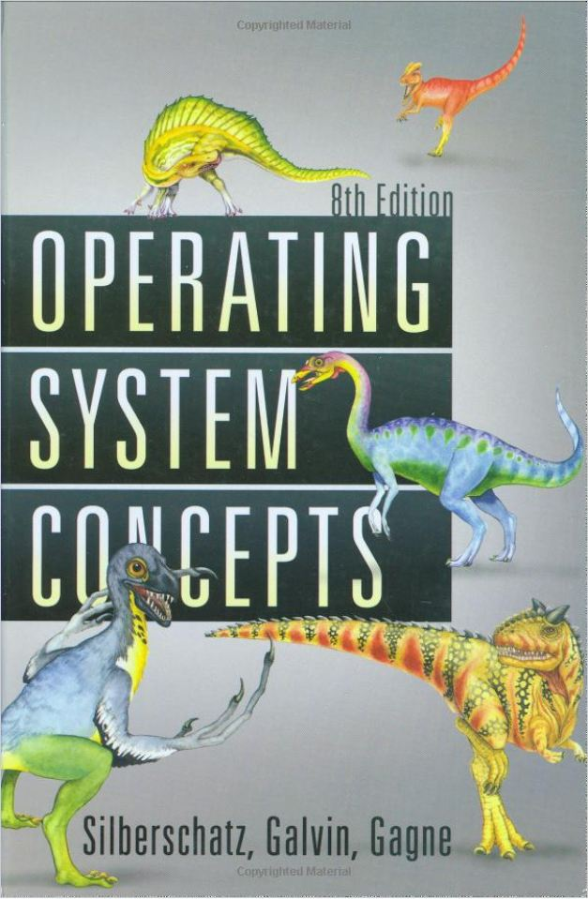
Textbook
Operating System Concepts, Any (>5th) ed., Silberschatz, Galvin and Gagne, John Wiley & Sons, Inc

Slide 6

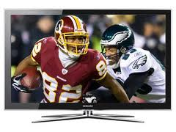

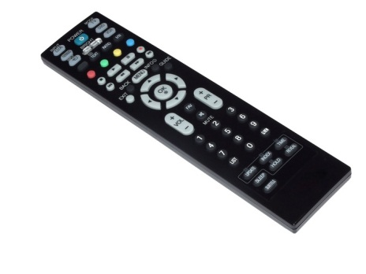
Operating System: An Intuitive Concept

Slide 7

Operating System: An Intuitive Concept
What can you do for your new smart TV against your nephew?
You are doing exactly what OS does for computer HW against users !

Slide 8
What You Do and What OS Does
You enables your nephews to use TV
Conveniently
So that even your little nephew can use smart TV
Efficiently
Arbitrate between two nephews combating for channels
Effectively
Prevent from meaningless button pressing
Securely
Keep TV secure against rash behaviors of nephew
Protectively
Keep your nephew out of adults channels
OS enables users to use computer
Conveniently
So that even fresh users can use the computer
Efficiently
Arbitrate between multiple jobs combating for resources
Effectively
Prevent from meaningless resource usage
Securely
Keep HW secure against malfunctioning jobs
Protectively
Keep other users out of your files

Slide 9
OS Strategy to achieve the goals
Cheating
which is
Solid
Sustainable
Fault-tolerant
and unpunishable

Slide 10
Course Goal
To make students truly understand that
OS is a collection of cheating schemes

Slide 11
Examples
Process management: Multitasking
Cheating by fast and repetitive task switches
Memory management: Virtual Memory
Cheating by a phantom space provision
File and Storage management: Fast I/O
Cheating by buffering and caching

Slide 12
Conclusion and Q&A
Understood?
Then your are ready to take this Operating System course!
Good Luck to you!

